Slide 1
Introduction to Processing with p5.js
By Crystal Hess
http://csed.fun

Slide 2
Learning Goals
What is p5.js?
What is “the documentation”?
How does the coordinate system work in p5.js?
What can a for-loop be used for?
Note similarities between programming languages used to code in p5.js (JavaScript) and Arduino (c/c++)

Slide 3
What is p5.js?
JavaScript language
Runs in a web browser
Spin off from processing.org
Great for artists, designers, and beginning programmers

Slide 4
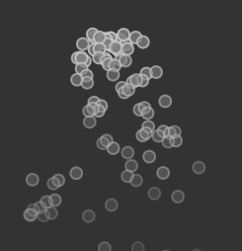

Slide 5
Example: Shapes
Open the Example: Hello → Shapes
Play with the code!
How does p5.js look similar to the Arduino language?
How does it look different?

Slide 6
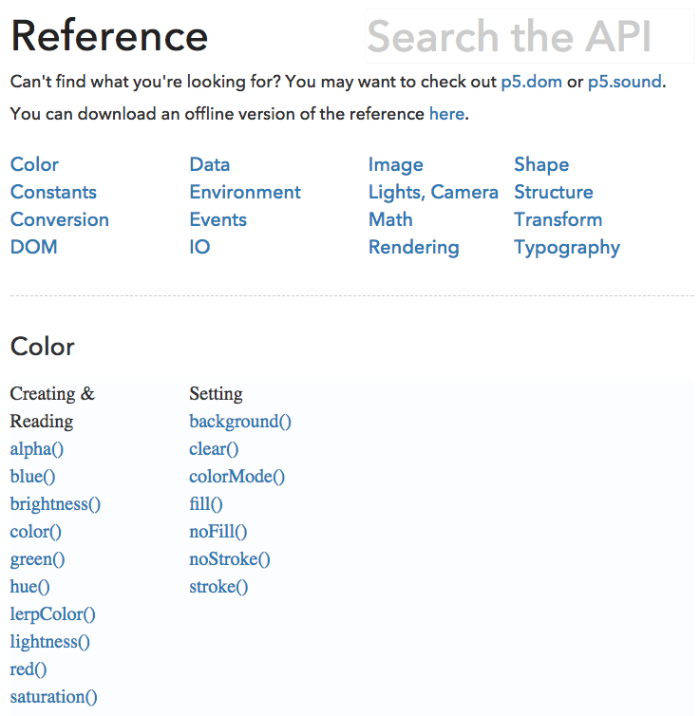
The p5.js API
Read the Documentation!

Slide 7
Example: Shapes
Using the p5.js documentation, answer the following:
What are the two values that are passed to createCanvas?
What is the value that is passed to background? What is the possible range for this value?
What are the values passed to fill and stroke?
Figure out how rect, ellipse, and triangle work.
How does the coordinate system work on the canvas?
Where is the origin?
With a canvas that is passed 720,400, where about is the point 700,400?
What does it mean when the documentation puts an argument in brackets? e.g. color(v1,v2,v3,[alpha])
Then,
Create a square white canvas.
Create 4 shapes that are equal in width and height, but each different in color.
Create a large semi-transparent “pacman” that looks like it is eating your shapes.

Slide 8
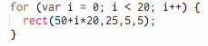
For Loops
Consider the code here
Can you make the line of squares longer?
Can you make the squares appear at the bottom of the canvas instead of the top?
Can you space the squares farther apart?
Can you make the squares larger?
Can you make a border around your canvas of these small squares? (You will need to use one loop per side of the canvas.)
Added Fun
Make each square that appears be a random color

